Slide 1
MySQL + Hibernate
Alicja Salamon, Dawid Aksamit

Slide 2
O MySQL
Kod źródłowy dostępny na warunkach GNU General Public License
Popularny wśród webowych aplikacji – część szeroko rozpowszechnionego LAMP - złożonego open sourcowych: Linux, Apache, MySQL, Perl/PHP/Python
Był pisany raczej z myślą o szybkości niż kompatybilności ze standardem SQL, dopiero w wersji 5 dodano procedury składowane, trigery, widoki
W czołówce światowej – używany np. w:
Wikipedia
Google (chociaż nie dla wyszukiwań)
Facebook
Twitter
YouTube

Slide 3
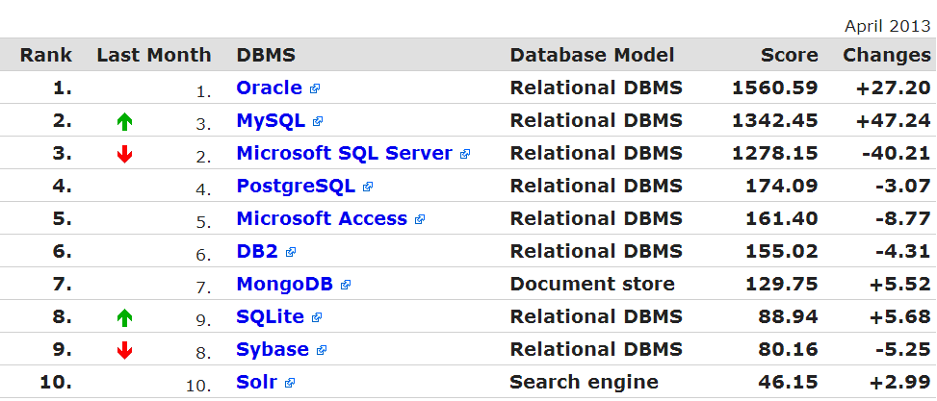
http://db-engines.com/en/ranking

Slide 4
O MySQL - wady
Podobnie jak inne SQLowe bazy danych, MySQL nie spełnia wszystkich wymagań zdefiniowanych przez standard SQL. (np. w silnikach innych niż InnoDB nie są obsługiwane klucze obce)
Ilość triggerów jest ograniczona do jednego na daną akcję (np. możemy dodać tylko po jednym triggerze przed i po wstawianiem do tej samej tabeli)
Nie ma triggerów na widoki
Podobnie jak inne transakcyjne relacyjne bazy danych MySQL jest ograniczony przez wydajność dysku. Jest to szczególnie ważne w odniesieniu do zapisu.

Slide 5
O Hibernate
Open source - objęty licencją source GNU Lesser General Public License (LGPL) – można pobierać i używać kodu źródłowego
Hibernate is a high-performance Object/Relational persistence and query service. The most flexible and powerfulObject/Relational solution on the market, Hibernate takes care of the mapping from Java classes to database tables and from Java data types to SQL data types. It provides data query and retrieval facilities that significantly reduce development time. Hibernate’s design goal is to relieve the developer from 95% of common data persistence-related programming tasks by eliminating the need for manual, hand-crafted data processing using SQL and JDBC. However, unlike many other persistence solutions, Hibernate does not hide the power of SQL from you and guarantees that your investment in relational technology and knowledge is as valid as always.
Working with both Object-Oriented software and Relational Databases can be cumbersome and time consuming. Development costs are significantly higher due to a paradigm mismatch between how data is represented in objects versus relational databases. Many software developers and architects estimate that up to 30% of their code is needed to deal with this infrastructure concern. Hibernate directly addresses this challenge by providing the ability to map an object model’s data representation to a relational data model and its corresponding database schema.
Hibernate eliminates repetitive and tedious coding work and enables developers to focus on the business problem. No matter which application development strategy you prefer--starting top-down with a new business problem and model or bottom up with an existing database schema--Hibernate can significantly reduce development time and as a provider of Object/Relational persistence solution will significantly reduce lines of code. Hibernate provides a buffer between the two data representations and enables a more elegant use of object orientation on the Java side--all while keeping the relational schema normalized and guaranteeing data integrity.

Slide 6
Why hibernate
Natural Programming Model: Hibernate lets you develop persistent classes following natural Object-oriented idioms including inheritance, polymorphism, association, composition, and the Java collections framework.
Transparent Persistence: Hibernate requires no interfaces or base classes for persistent classes and enables any class or data structure to be persistent. Furthermore, Hibernate enables faster build procedures since it does not introduce build-time source or byte code generation or processing.
High Performance: Hibernate supports lazy initialization, many fetching strategies, and optimistic locking with automatic versioning and time stamping. Hibernate requires no special database tables or fields and generates much of the SQL at system initialization time instead of runtime. Hibernate consistently offers superior performance over straight JDBC coding.
Reliability and Scalability: Hibernate is well known for its excellent stability and quality, proven by the acceptance and use by tens of thousands of Java developers. Hibernate was designed to work in an application server cluster and deliver a highly scalable architecture. Hibernate scales well in any environment: Use it to drive your in-house Intranet that serves hundreds of users or for mission-critical applications that serve hundreds of thousands.
Extensibility: Hibernate is highly customizable and extensible.
Comprehensive Query Facilities: Including support for Hibernate Query Language (HQL), Java Persistence Query Language (JPAQL), Criteria queries, and "native SQL" queries; all of which can be scrolled and paginated to suit your exact performance needs.

Slide 7
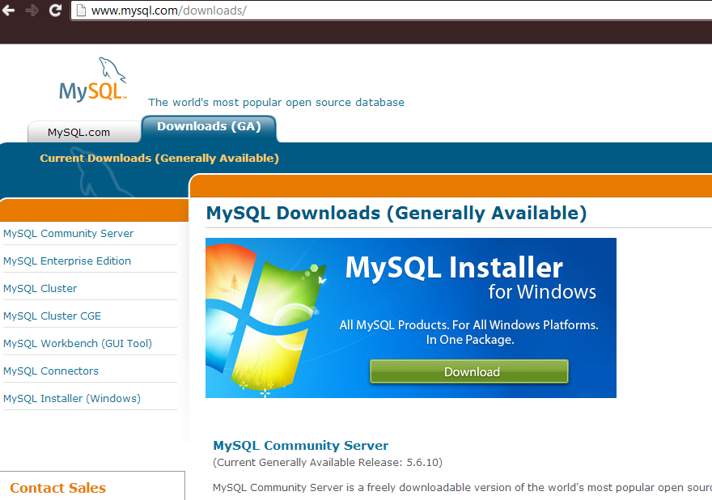
1. Instalacja MySQL

Slide 8
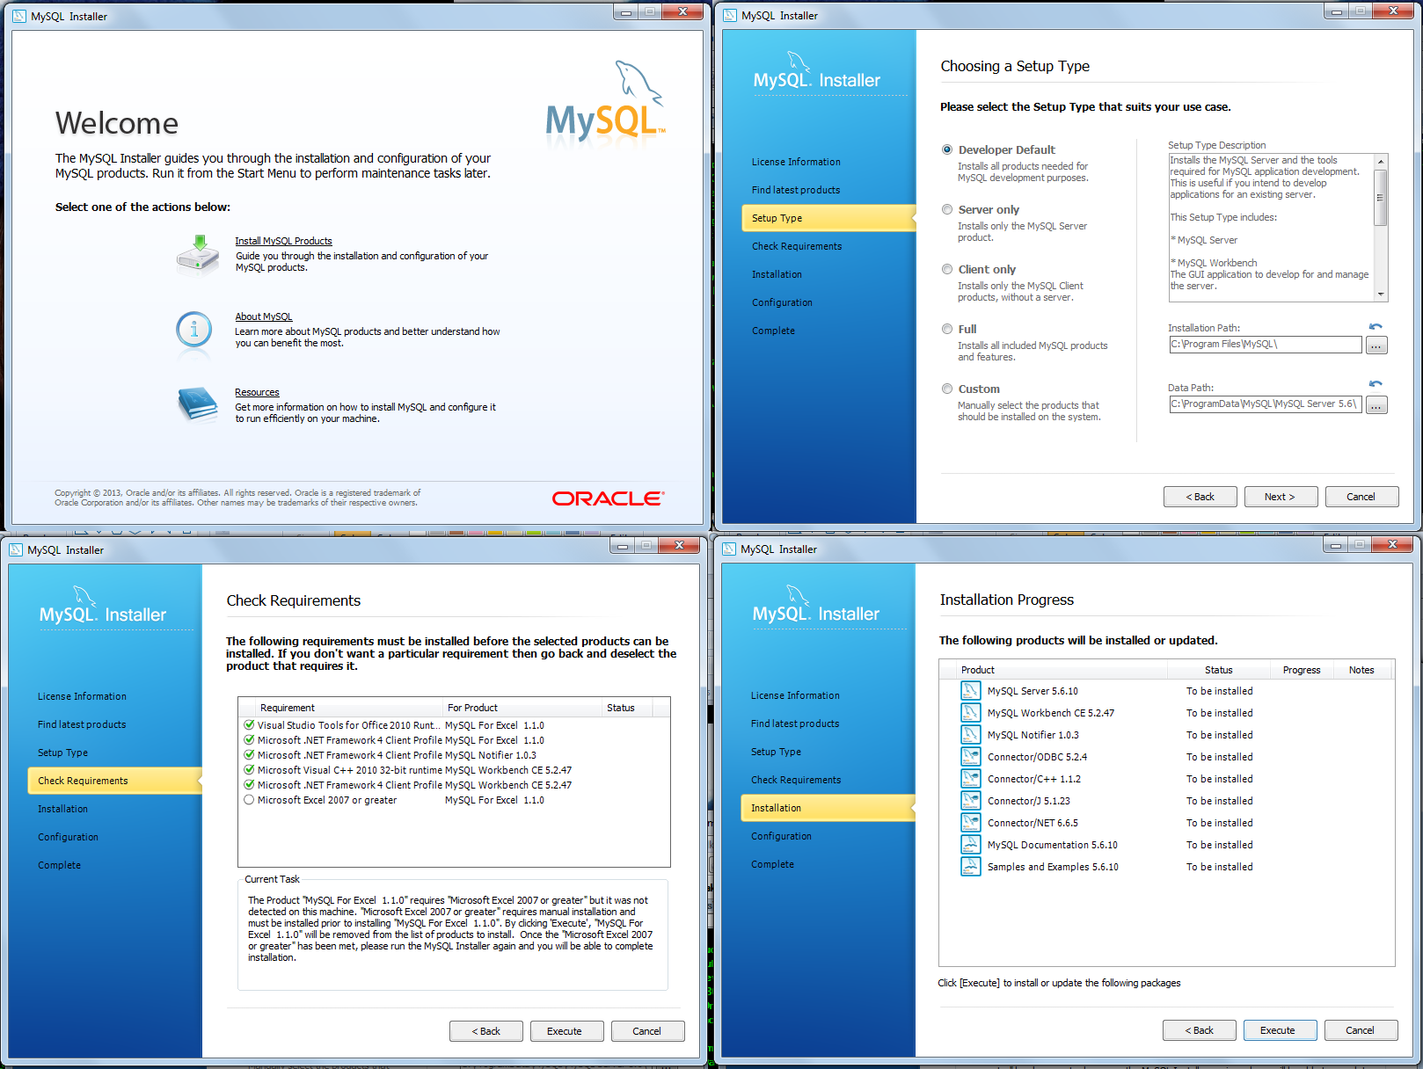

Slide 9
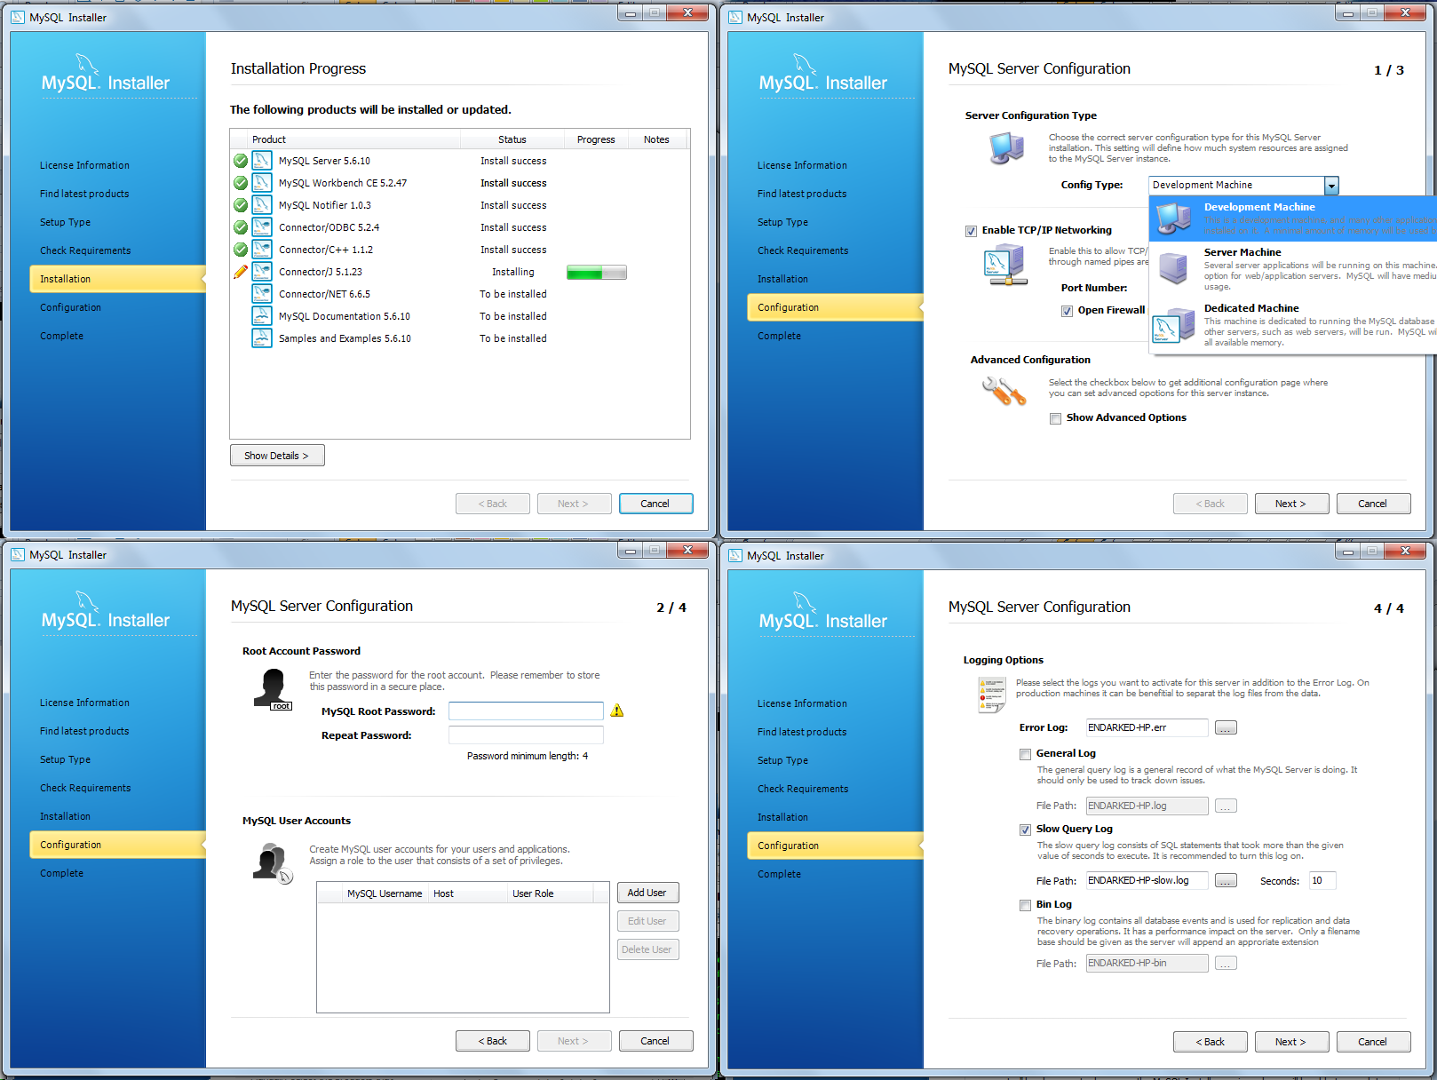

Slide 10
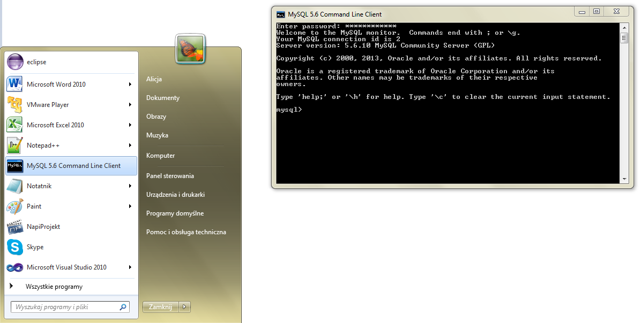
2a. Uruchomienie – command line

Slide 11
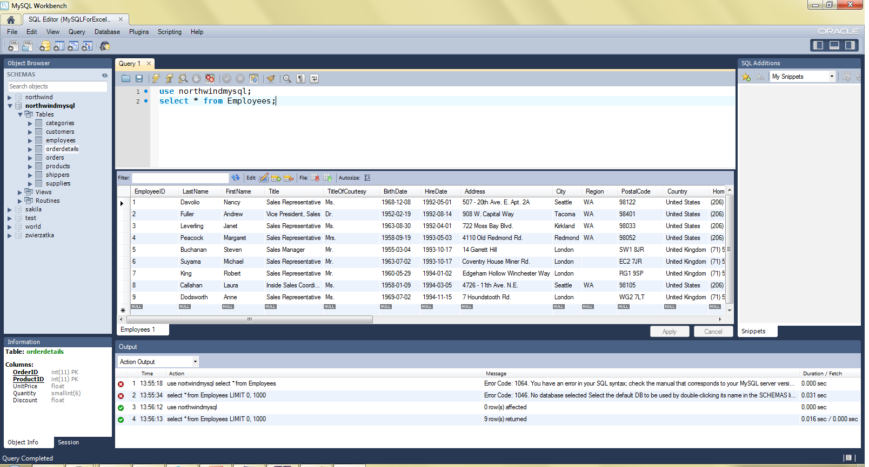
2b. Uruchomienie - Workbench

Slide 12
Tworzenie bazy danych
mysql> CREATE DATABASE northwind;
Query OK, 1 row affected (0.16 sec)
mysql> drop DATABASE nortwind;
Query OK, 0 rows affected (1.28 sec)
mysql> show databases;
+--------------------+
| Database |
+--------------------+
| information_schema |
| mysql |
| northwind |
| test |
| world |
+--------------------+
mysql> USE northwind
Database changed
mysql> show tables;
+--------------------------+
| Tables_in_northwind |
+--------------------------+
| categories |
| customers |
| employees |
| orderdetails |
| orders |
| products |
| shippers |
| suppliers |
+--------------------------+

Slide 13
Tworzenie tabeli
CREATE TABLE Products( ProductID INT NOT NULL AUTO_INCREMENT, ProductName VARCHAR(40) NOT NULL, SupplierID INT NOT NULL, CategoryID INT NOT NULL, QuantityPerUnit VARCHAR(20), UnitPrice FLOAT DEFAULT 0, UnitsInStock SMALLINT DEFAULT 0, UnitsOnOrder SMALLINT DEFAULT 0, ReorderLevel SMALLINT DEFAULT 0, Discontinued TINYINT DEFAULT 0 NOT NULL, FOREIGN KEY (CategoryID) REFERENCES Categories (CategoryID), FOREIGN KEY (SupplierID) REFERENCES Suppliers (SupplierID), PRIMARY KEY (ProductID), INDEX ProductName (ProductName)
)ENGINE=InnoDB;

Slide 14
Opis tabeli
mysql> describe Products;
+-----------------+---------------+------+-----+---------+----------------+
| Field | Type | Null | Key | Default | Extra |
+-----------------+---------------+------+-----+---------+----------------+
| ProductID | int(11) | NO | PRI | NULL | auto_increment |
| ProductName | varchar(40) | NO | | NULL | |
| SupplierID | int(11) | NO | MUL | NULL | |
| CategoryID | int(11) | NO | MUL | NULL | |
| ContactName | varchar(30) | NO | | NULL | |
| QuantityPerUnit | varchar(20) | NO | | NULL | |
| UnitPrice | decimal(10,2) | NO | | NULL | |
| UnitsInStock | smallint(6) | NO | | NULL | |
| UnitsOnOrder | smallint(6) | NO | | NULL | |
| ReorderLevel | smallint(6) | YES | | NULL | |
| Discounted | bit(1) | NO | | NULL | |
+-----------------+---------------+------+-----+---------+----------------+

Slide 15
Wstawianie danych
INSERT INTO `categories`
(`CategoryID`, `CategoryName`, `Description`, `Picture`) VALUES
(1, 'Beverages', 'Soft drinks, beers, and ales', NULL),
(2, 'Condiments', 'Sweet and savory sauces', ''),
(3, 'Confections', 'Desserts, candies, and sweet breads', ''),
(4, 'Dairy Products', 'Cheeses', ''),
(5, 'Grains/Cereals', 'Breads, crackers, pasta, and cereal', ''),
(6, 'Meat/Poultry', 'Prepared meats', ''),
(7, 'Produce', 'Dried fruit and bean curd', ''),
(8, 'Seafood', 'Seaweed and fish', '');
LOAD DATA LOCAL INFILE '/path/data.txt' INTO TABLE Categories LINES TERMINATED BY '\r\n';

Slide 16
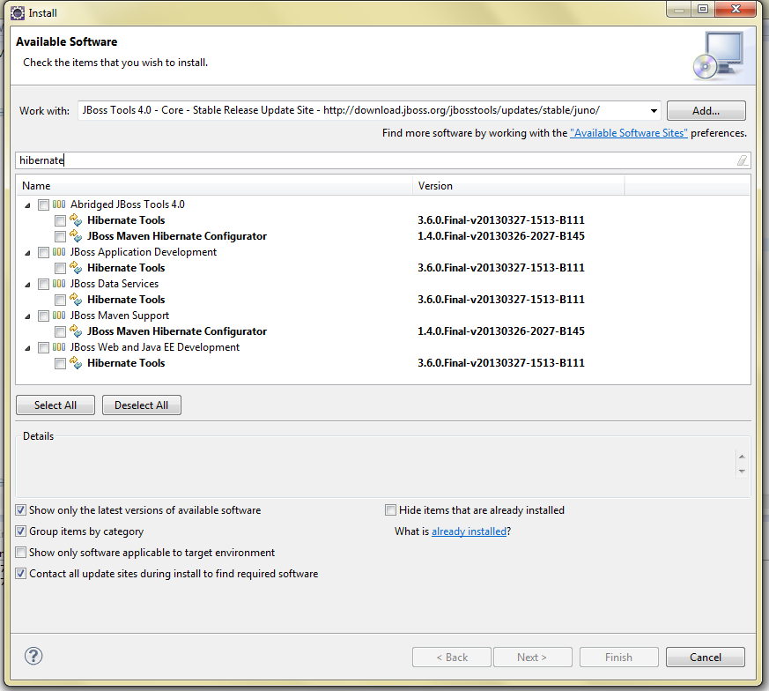
Wtyczka do Eclipsa
http://download.jboss.org/jbosstools/updates/stable/juno/

Slide 17
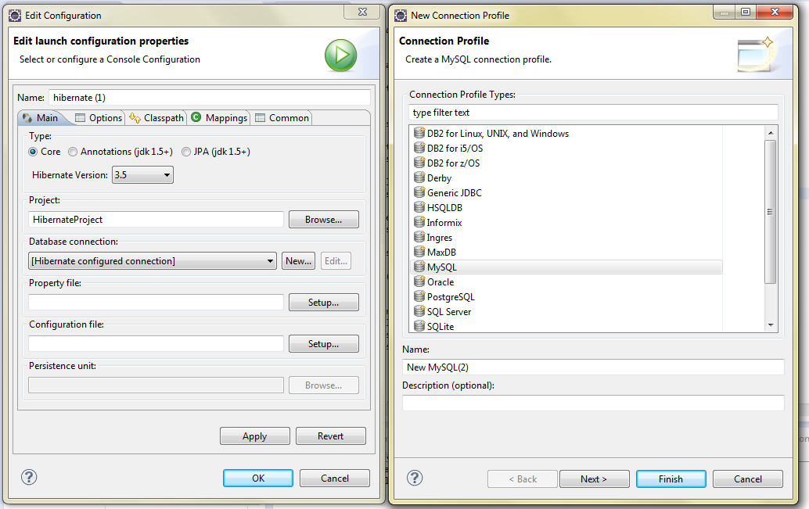
Nowe połączenie

Slide 18
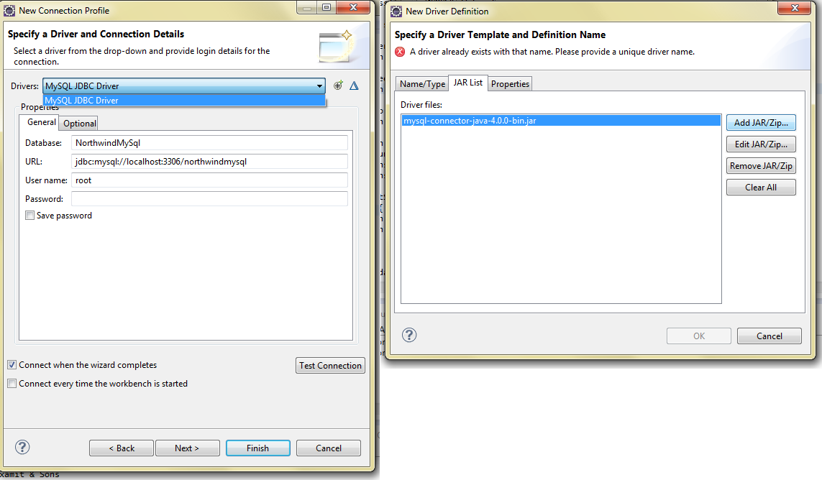
Sterownik
http://www.mysql.com/downloads/connector/j/

Slide 19
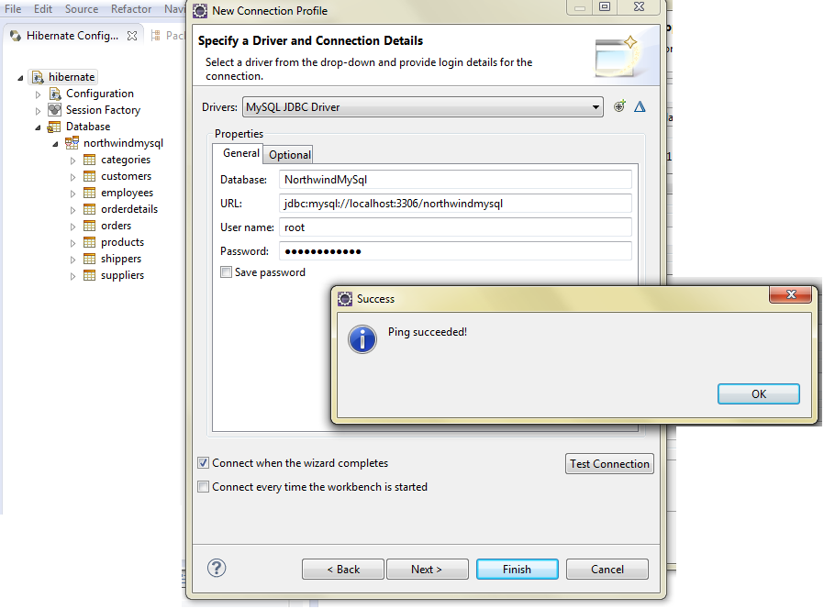
Ping

Slide 20
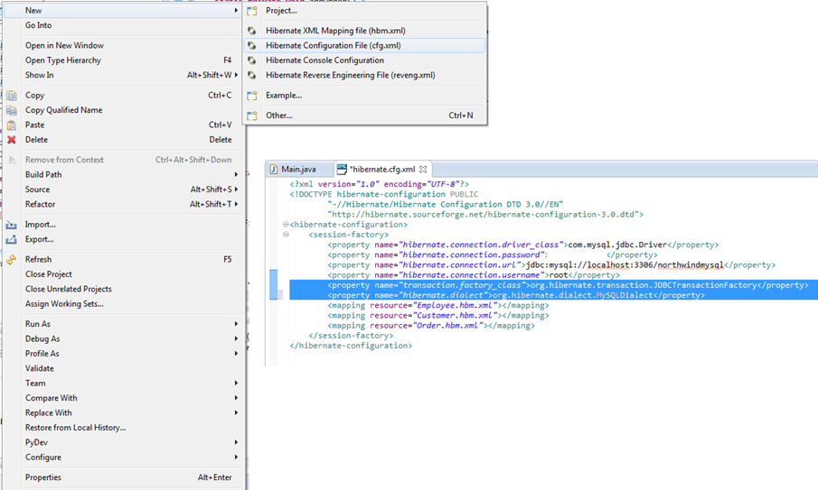
hibernate.cfg.xml

Slide 21
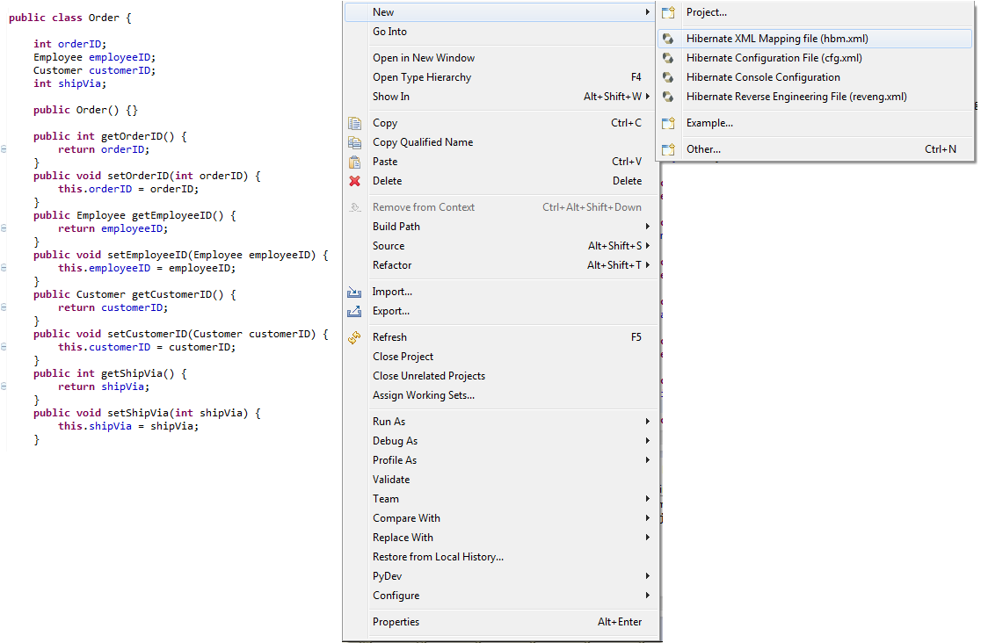
POJO + mapping file

Slide 22
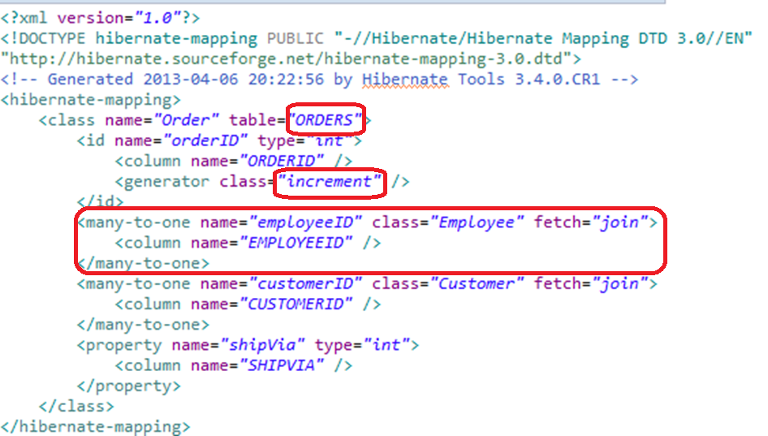
Order.hbm.xml

Slide 23
Session Factory
private static SessionFactory sessionFactory;
private static ServiceRegistry serviceRegistry;
private static SessionFactory buildSessionFactory() {
try {
// Create the SessionFactory from hibernate.cfg.xml
Configuration configuration = new Configuration().configure();
serviceRegistry = new ServiceRegistryBuilder().applySettings(
configuration.getProperties()).buildServiceRegistry();
sessionFactory = configuration.buildSessionFactory(serviceRegistry);
return sessionFactory;
} catch (HibernateException he) {
throw new ExceptionInInitializerError(he);
}
}

Slide 24
Transakcje
Transaction trns = null;
Session session = HibernateUtil.getSessionFactory().openSession();
try {
trns = session.beginTransaction();
//...tu coś istotnego
session.getTransaction().commit();
} catch (RuntimeException e) {
if (trns != null)
trns.rollback();
e.printStackTrace();
} finally {
session.flush();
session.close();
}

Slide 25
Create…
Customer c = new Customer("AXAMI", "Aksamit INC.");
session.save(c);
Employee e = new Employee("Alicja", "Salamon", "Krakow");
session.save(e);
Order o = new Order(e, c);
session.save(o);

Slide 26
Read…
List<Order> ordersList = newSession
.createSQLQuery("select * from Orders where OrderID=11078")
.addEntity(Order.class).list();
for (Iterator<Order> iter = ordersList.iterator(); iter.hasNext();) {
Order order = (Order) iter.next();
Employee empl = order.getEmployeeID();
Customer cust = order.getCustomerID();
System.out.println(order.getOrderID() + " by "
+ empl.getFirstName() + " " + empl.getLastName() + " for "
+ cust.getCompanyName());
}

Slide 27
Update…
Customer c = new Customer();
c.customerID = „SCINC";
c.companyName = „SomeCompany INC";
session.update(c);
Employee e = new Employee(„Jones", „John", „Warsaw");
e.EmployeeID=10;
session.update(e);

Slide 28
Delete…
Order o = new Order();
o.setOrderID(11078);
session.delete(o);
Customer c1 = new Customer();
c1.setCustomerID(„SCINC");
session.delete(c1);
Employee e = new Employee();
e.EmployeeID = 10;
session.delete(e);

Slide 29
Źródła
MySQL:
http://dev.mysql.com/doc/refman/5.0/en/tutorial.html
http://www.mysql.com/about/
http://stackoverflow.com/questions/260441/how-to-create-relationships-in-mysql
http://dev.mysql.com/doc/refman/5.0/en/innodb-foreign-key-constraints.html
http://www.artfulsoftware.com/mysqlbook/sampler/mysqled1_appe.html
Hibernate
http://www.hibernate.org/docs
http://blog.sencide.com/2011/03/hibernate-tutorial-for-beginners.html
http://viralpatel.net/blogs/hibernate-maven-mysql-hello-world-example-xml-mapping/
http://javabrains.koushik.org/p/hibernate.html
http://www.dzone.com/tutorials/java/hibernate/hibernate-example/hibernate-mapping-many-to-many-1.html

